Slide 1
Wood Duck Boxes
Eagle Scout Project 2014
Robert McKinney

Slide 2
Purpose
The purpose of this Eagle Scout project is to give the Wood Ducks a safe nesting home away from predators and the weather. Currently in the location that I want to put the Wood Duck boxes there is a low population of Wood Ducks. I am hoping that this increases the Wood Duck population.

Slide 3
What This Project Is
Eagle Scout Project
Building nesting boxes for Wood Ducks on Dewart Lake.
Increasing the Wood Duck population.
Community involvement between Dewart Lake and Ducks Unlimited.
Partnership with Greenwing Division of Ducks Unlimited for maintenance of boxes.

Slide 4
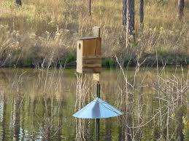
What the Project Looks Like
A box made of cedar wood with wood shavings inside for nesting. It will sit on a pier post 4-5 feet out of the water. There will be a predator guard placed below the box to keep all predator out, making it safe for the ducklings.

Slide 5
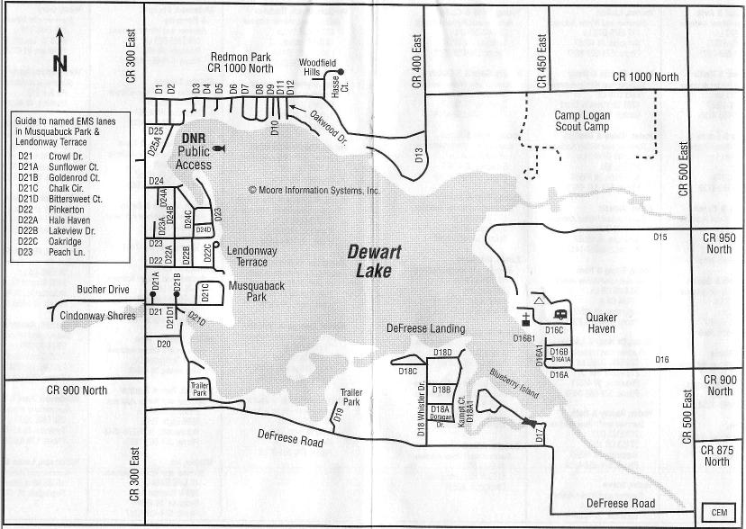
Where the Wood Duck Boxes Would Placed on Dewart Lake
I would like to place 4-5 Wood Duck boxes on the east corner of the lake by Blueberry Island. The red circle is approximately where I would place them.

Slide 6
Who Would Be Involved
Boy Scout Troop 728
Wawasee Chapter of Ducks Unlimited and Greenwings
Dewart Lake
Area Businesses through donations and monetary support.
Family and Friends

Slide 7
What the Approximate Cost of the Boxes Would Be and the Materials Needed
Cedar Wood Boards
Sheet Metal
Wood Screws
Sandpaper
Cedar Wood Shavings
Pier Post
The approximate cost is $350 for 5 Wood Duck Boxes.
This does not include the pier post that is needed.

Slide 8
What I Hope Happens
I hope that the population of Wood Ducks on Dewart Lake goes up and if it is effective maybe add a couple of more boxes in the future.
I am hoping that with my leadership and the partnership between Ducks Unlimited and myself that this becomes a program for the Greenwings to continue. Part of my goal is to continue for the next 3 years to help implement the program into the Greenwing division of Ducks Unlimited.
That other area lakes that have low populations of Wood Ducks use the idea of installing Wood Duck nesting boxes to increase the population.

