Slide 1
dewart lake watershed diagnostic study
Sara Peel
Arion Consultants

Slide 2
Today’s goals
Outline the three main phases of the watershed diagnostic study
Highlight the data we’ve collected to date
Solicit input from you and your knowledge of Skinner Lake and its drainage

Slide 3
Project Purpose
Describe conditions and trends in Dewart Lake & its watershed
Identify potential sources of water quality problems in the Dewart Lake Watershed
Propose specific directions for future work in the watershed
Prioritize potential watershed improvement projects

Slide 4
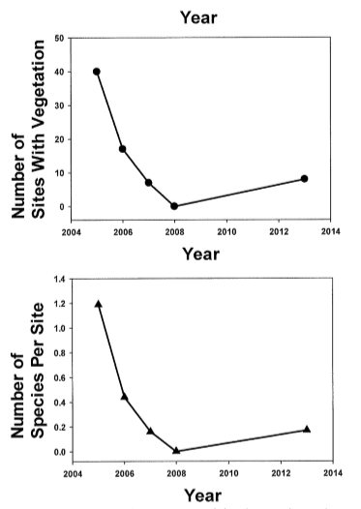
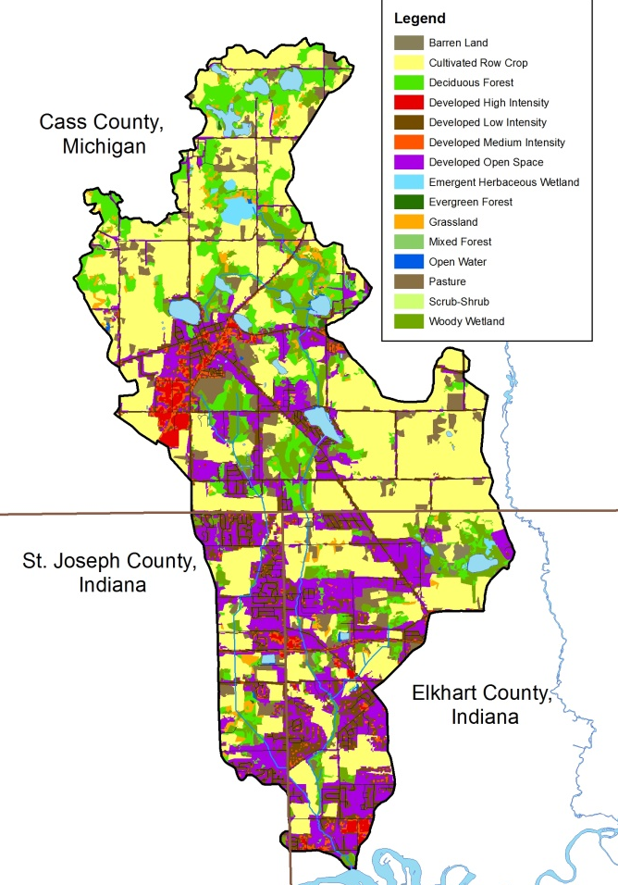
Task 1: Data Collection and Review
Desktop Mapping
Historic Data Collection

Slide 5
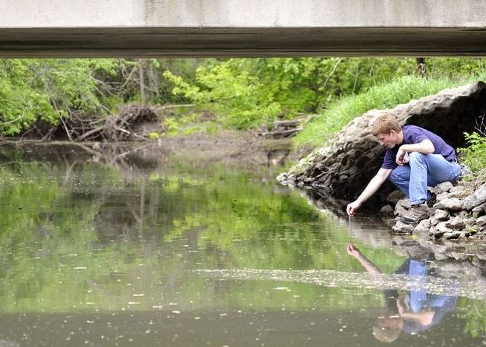
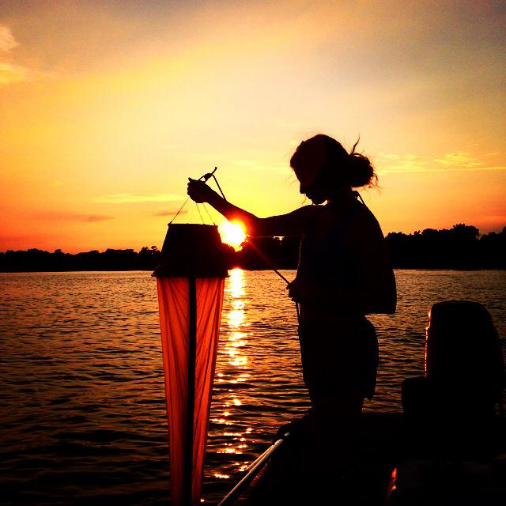
Task 2: Tributary and lake Data Collection
Storm Flow Stream Sampling (11 sites)
Stream habitat and aquatic bug sampling (4 sites)
In-lake monitoring (1 time – deepest point)
Watershed inventory – map concern areas and identify potential solutions

Slide 6
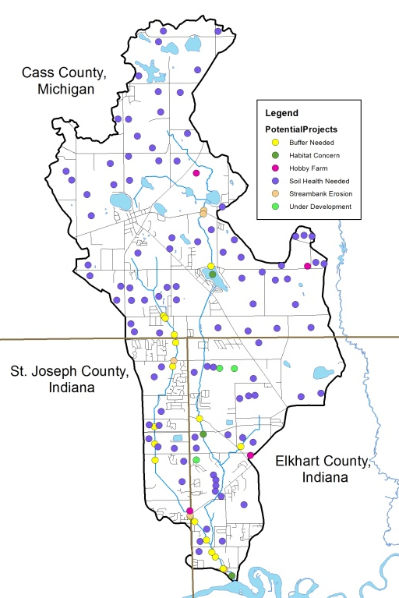
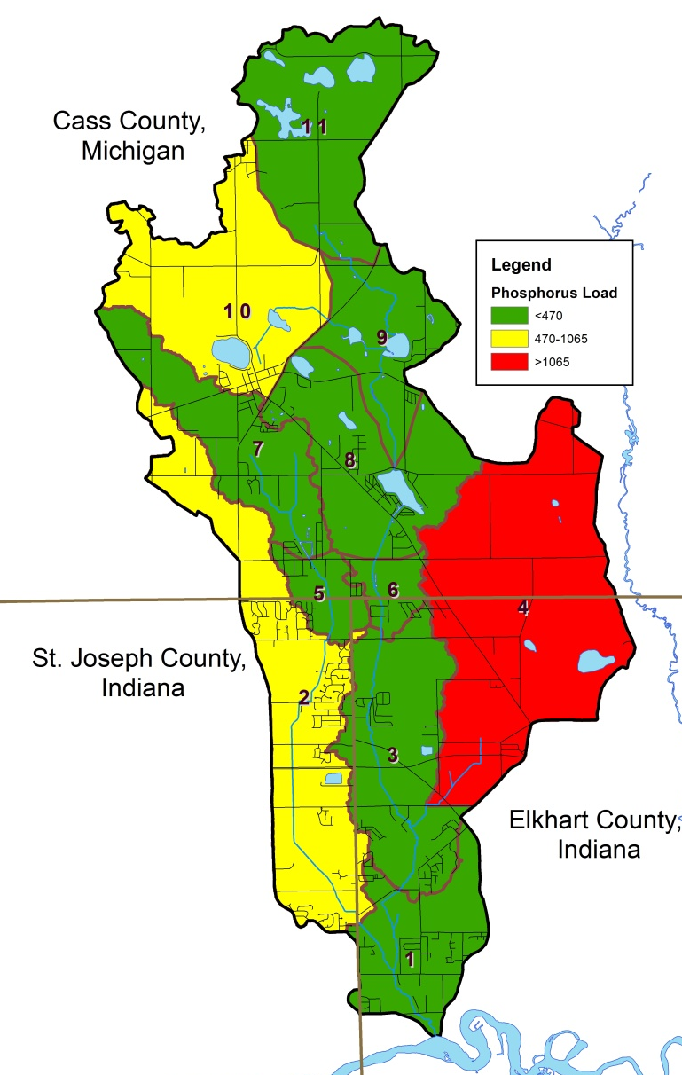
Task 3: Results Analysis and Interpretation
Data Assessment
Nonpoint Source Pollution Modeling
Future Effort Prioritization

Slide 7
dewart lake: data collection
Mapping

Slide 8
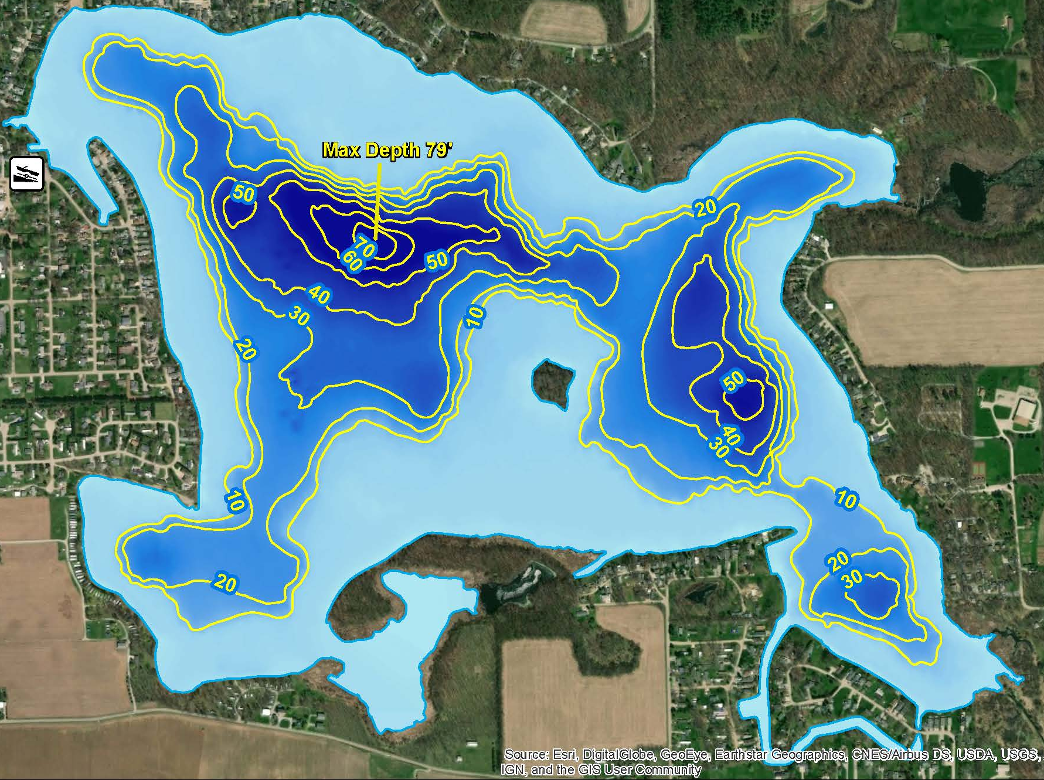
dewart lake
551 acres
79 feet max depth (2018); 82 feet (1963)
16.3 feet mean depth

Slide 9
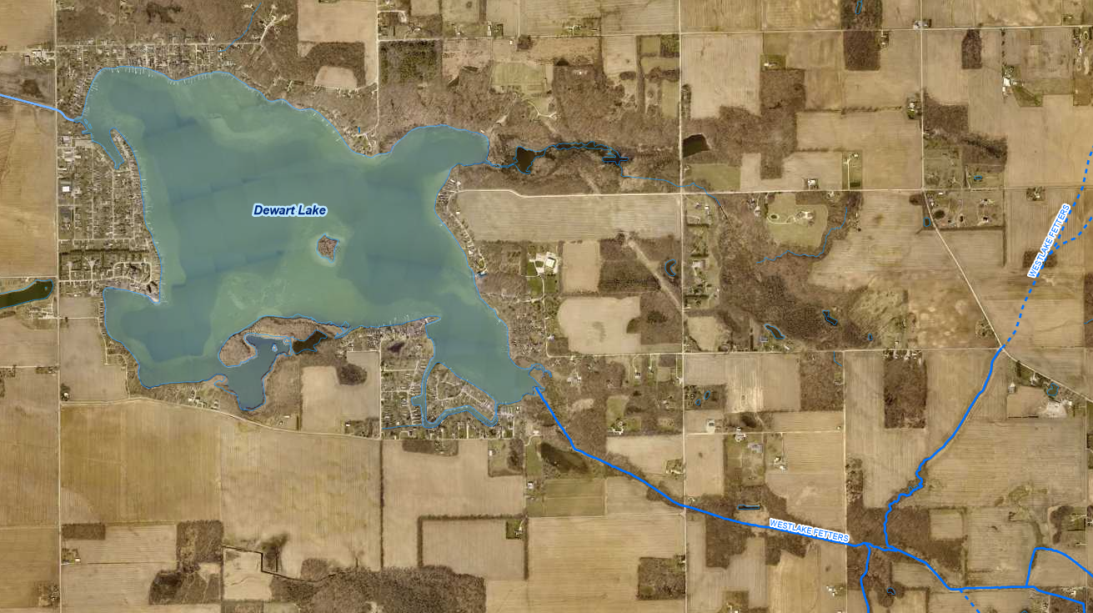
dewart lake tributaries
Tributaries:
  Cable Run/West Lake Fetters Ditch
  Unnamed wetland-based tributary
  Multiple ravines (north shore)

Slide 10
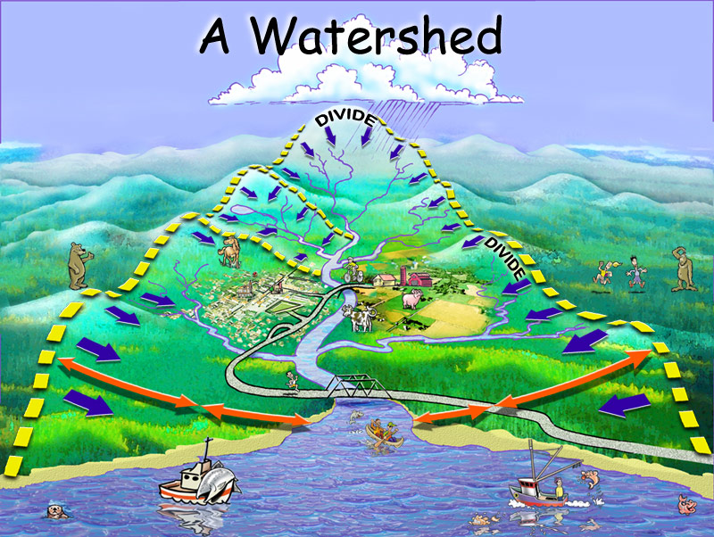

Slide 11
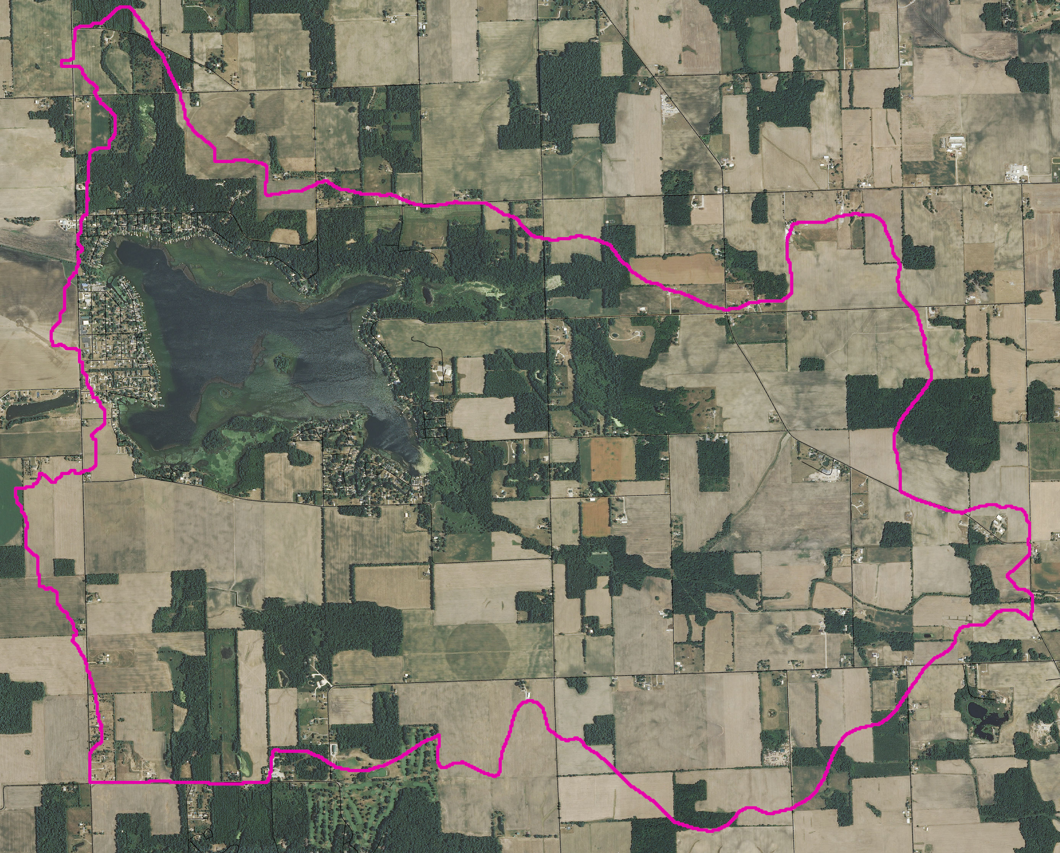
dewart lake Watershed
5,476 acres
Watershed area: Lake area =
9.9:1
(~10 acres of watershed for each acre of lake)

Slide 12
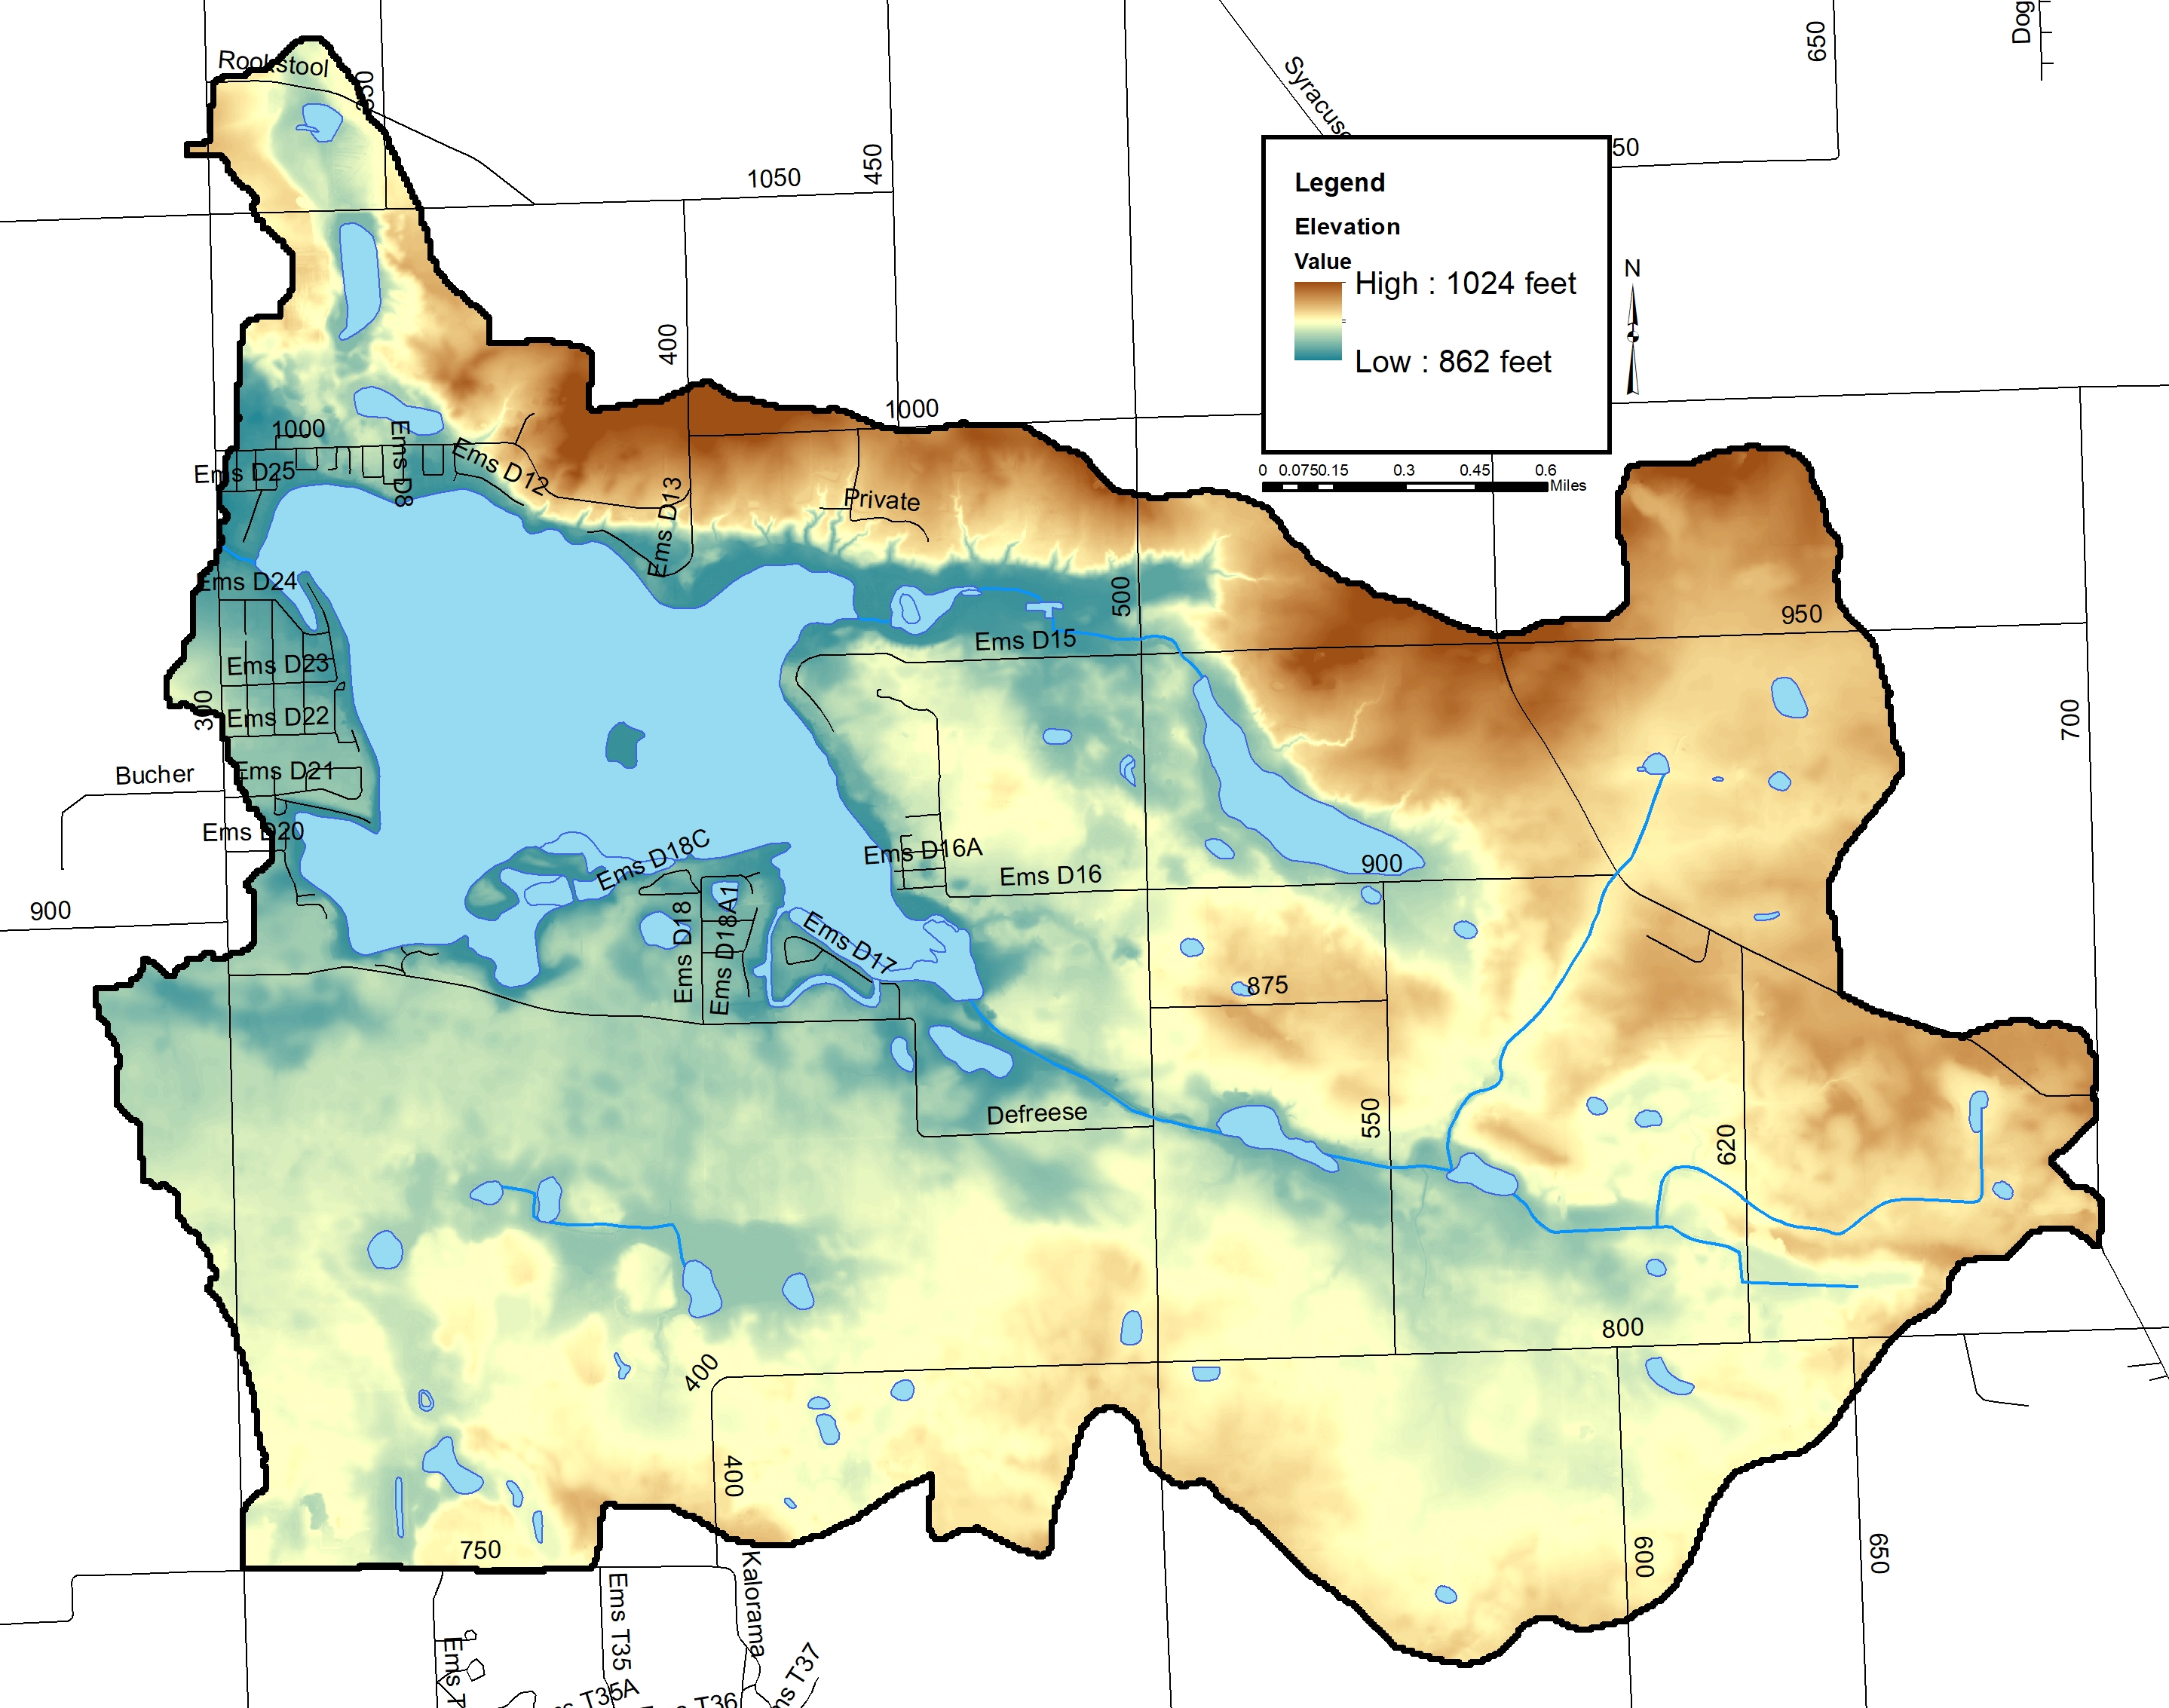
Elevation

Slide 13
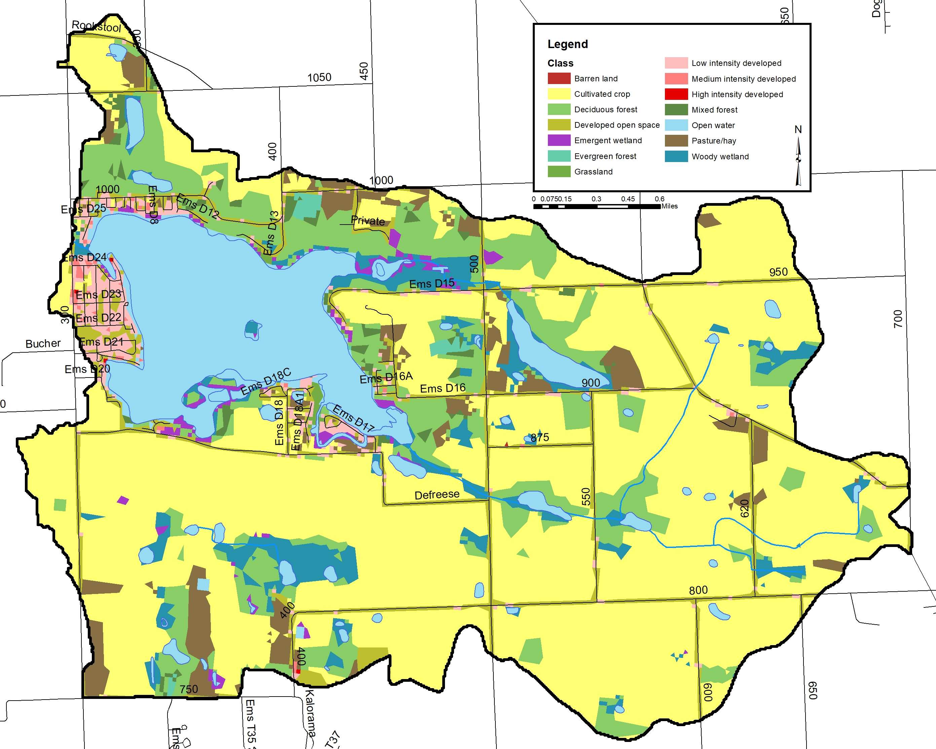
Land Use
2003 data:
70% agriculture (pasture, row crop)
15% natural (forested, wetland)
11% open water
4% developed (residential, commercial)
2022 data:
60% agriculture
23% natural
14% developed
8% open water

Slide 14
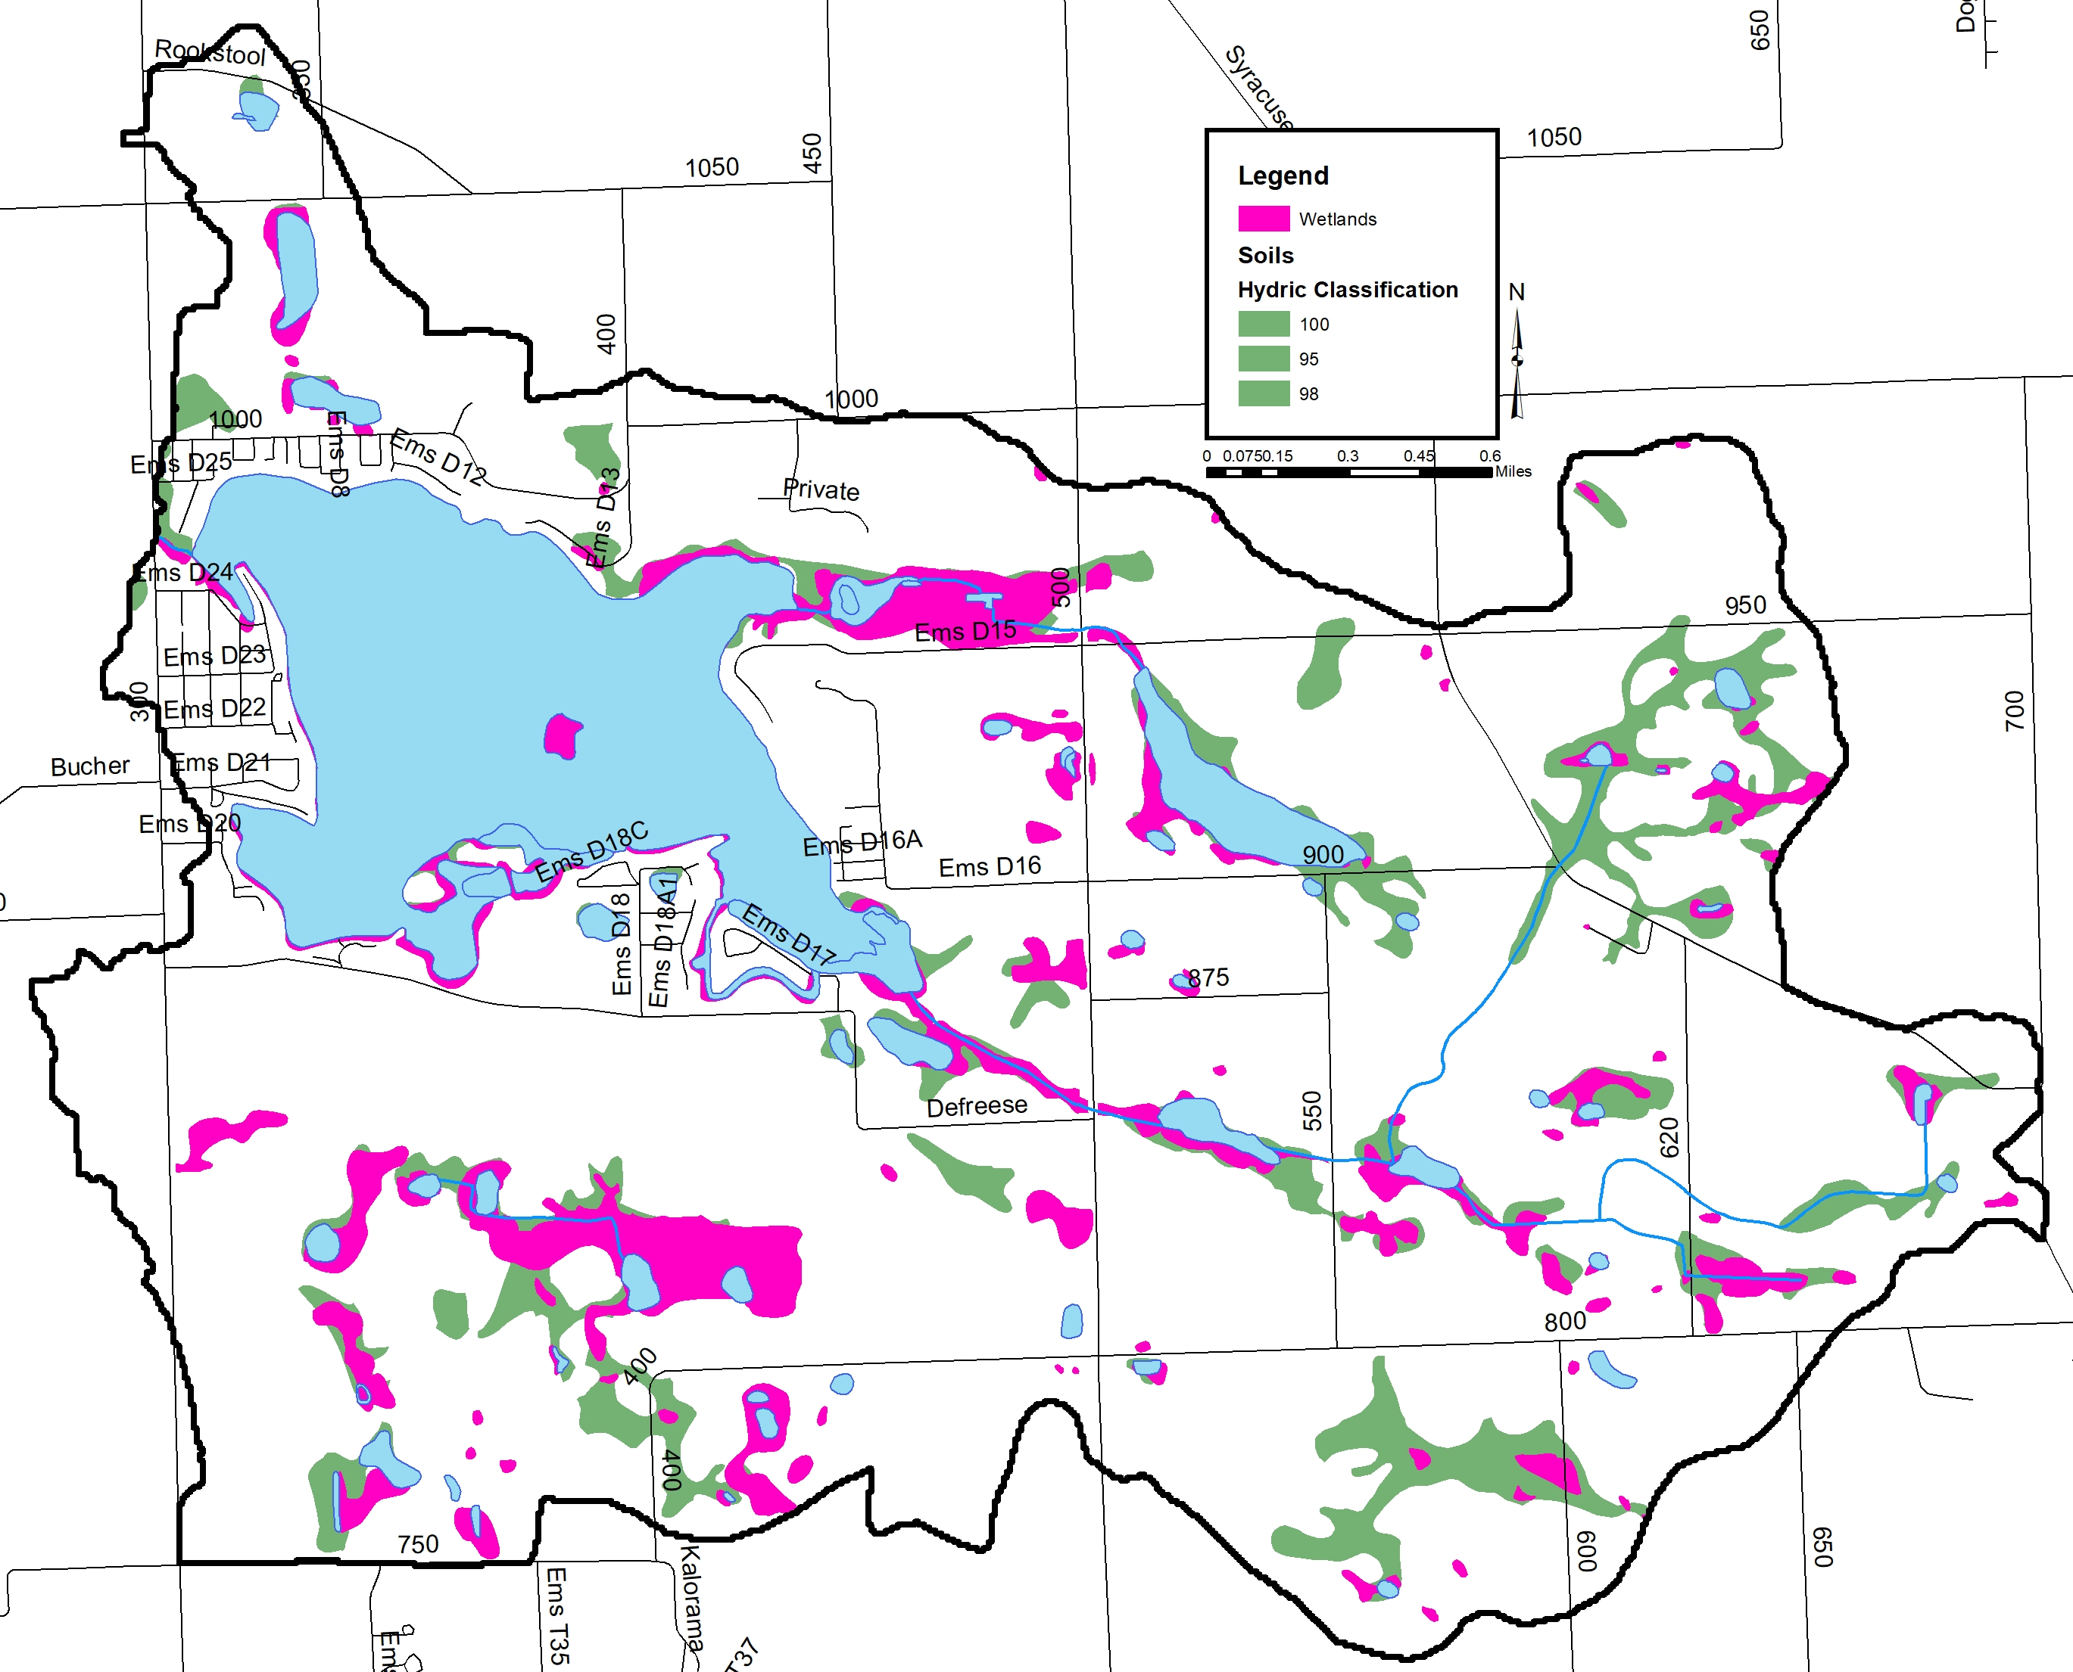
Wetlands and wetland Soils
Wetland (hydric) soils: 1,121 acres
Wetlands: 970 acres
151 acres lost or 13%

Slide 15
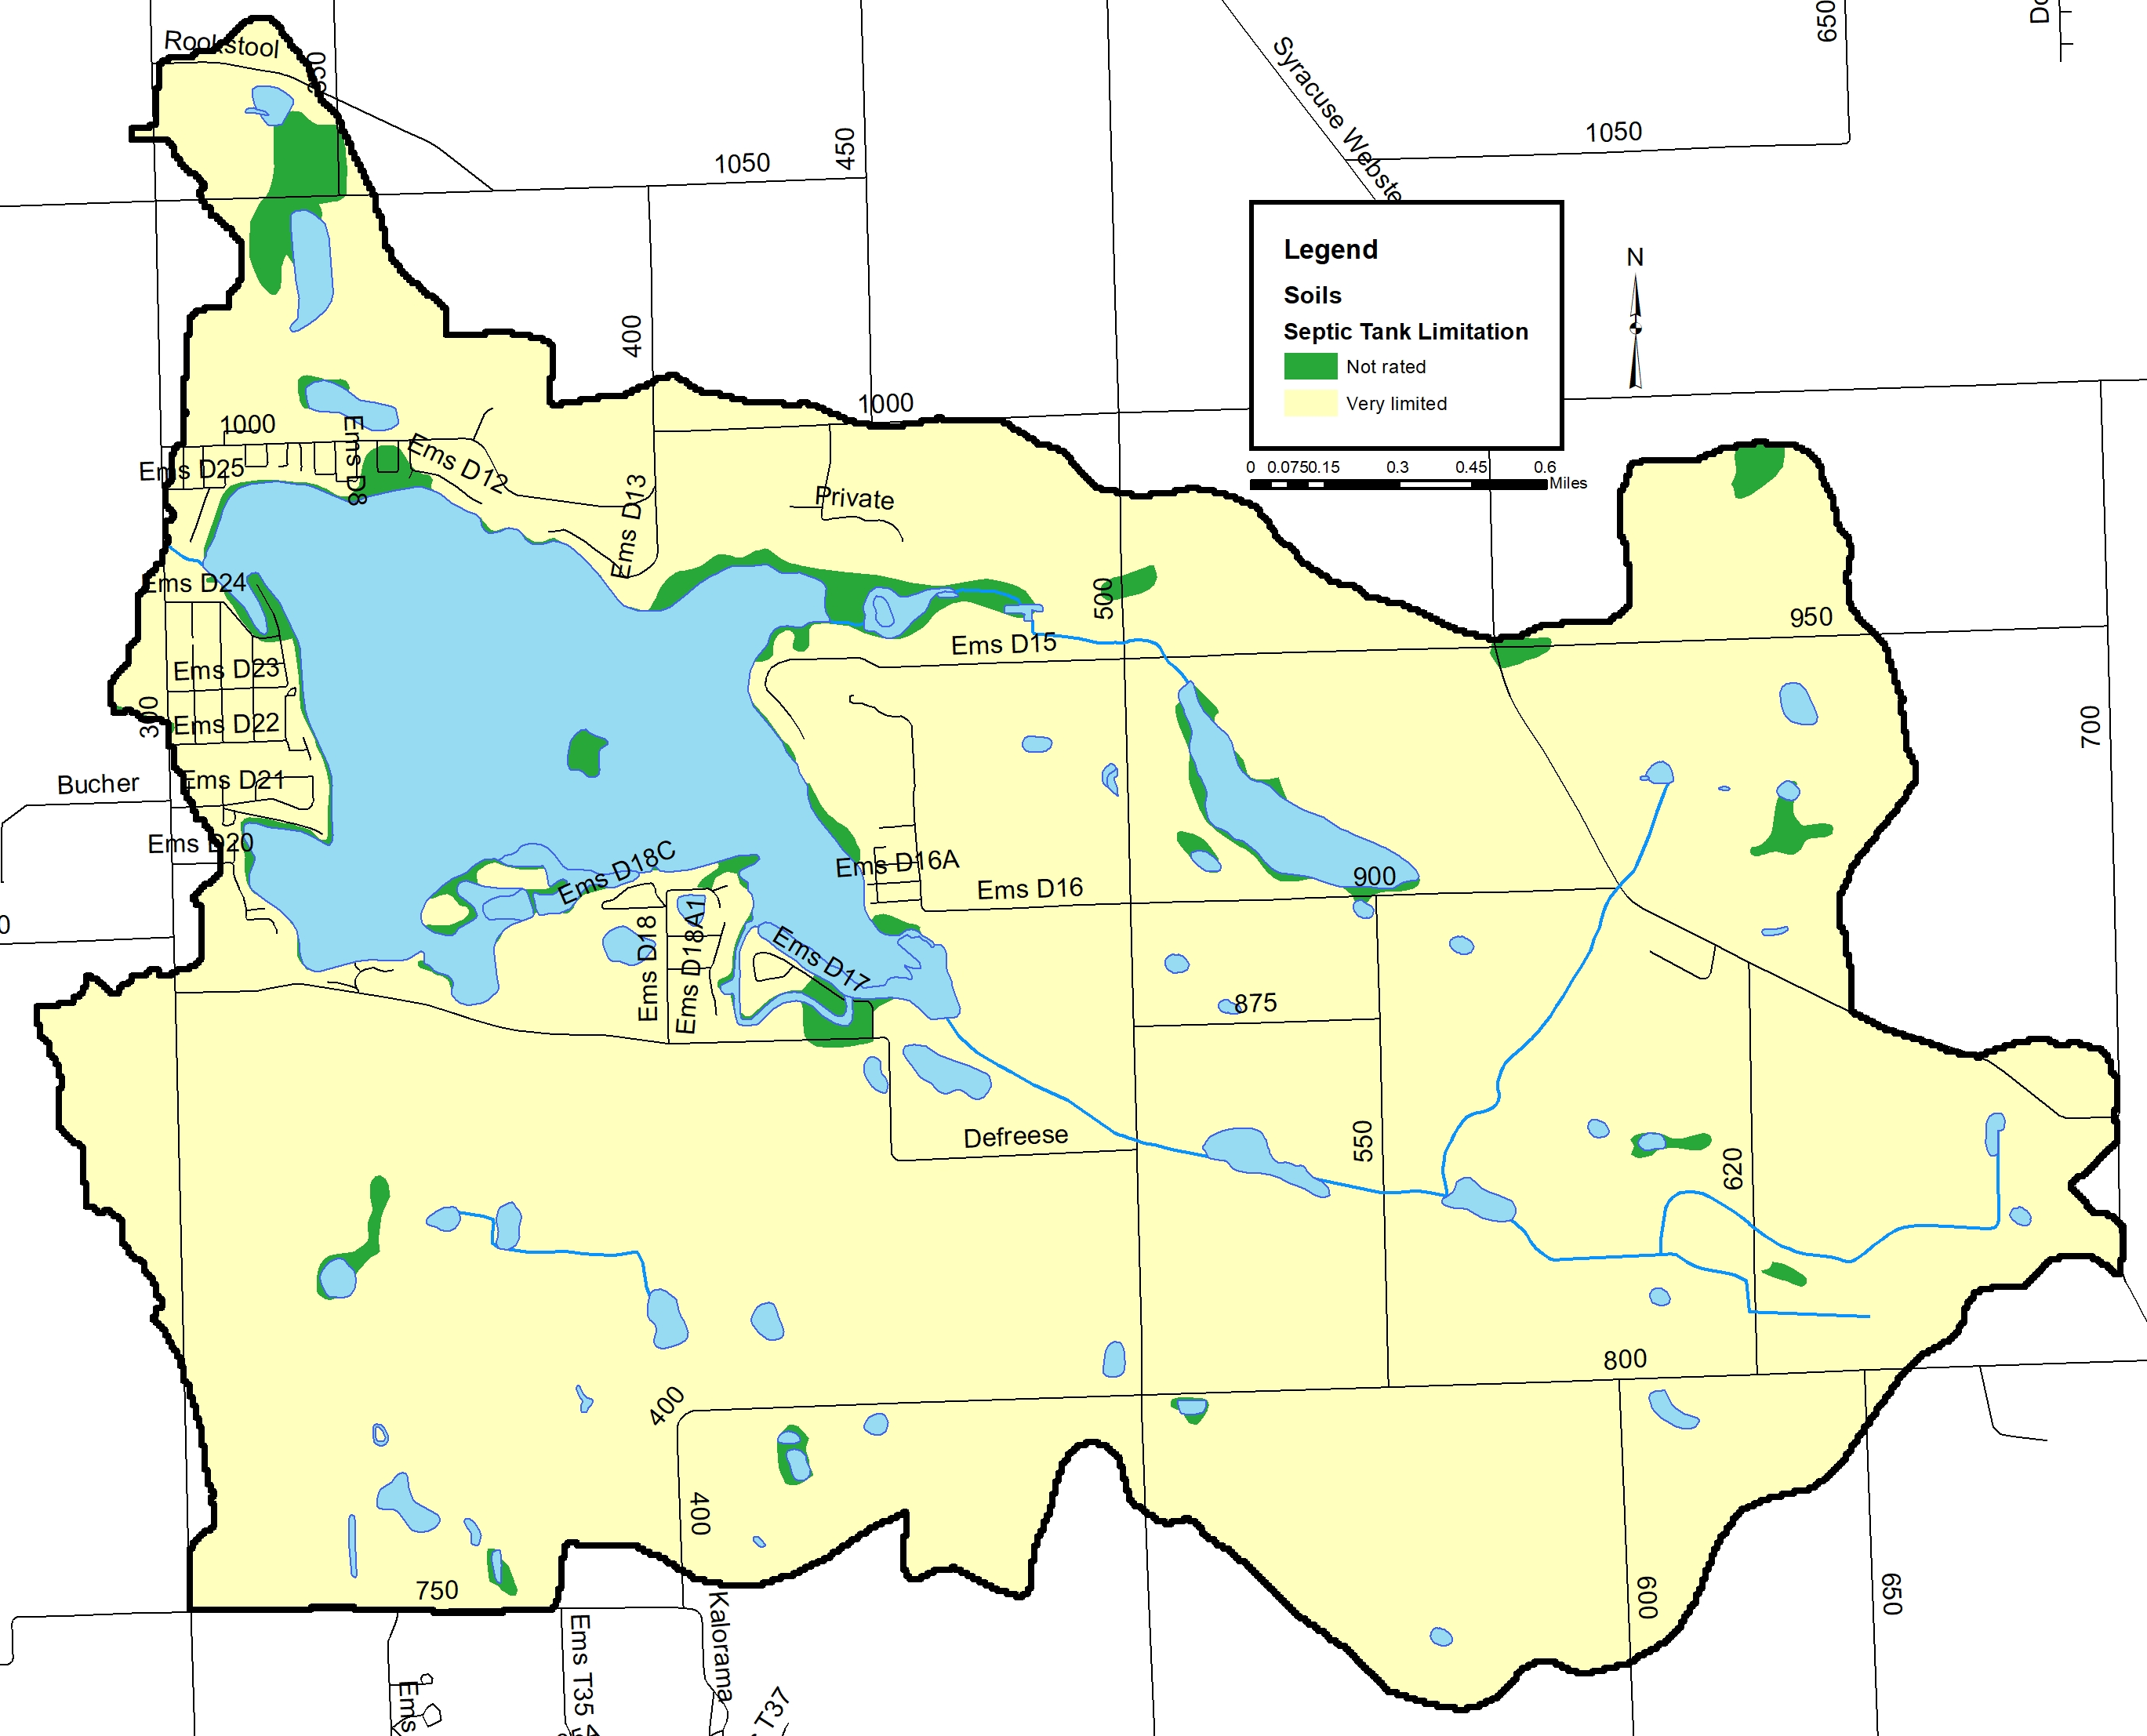
Septic Soils
4,734 acres of 86% very limited

Slide 16
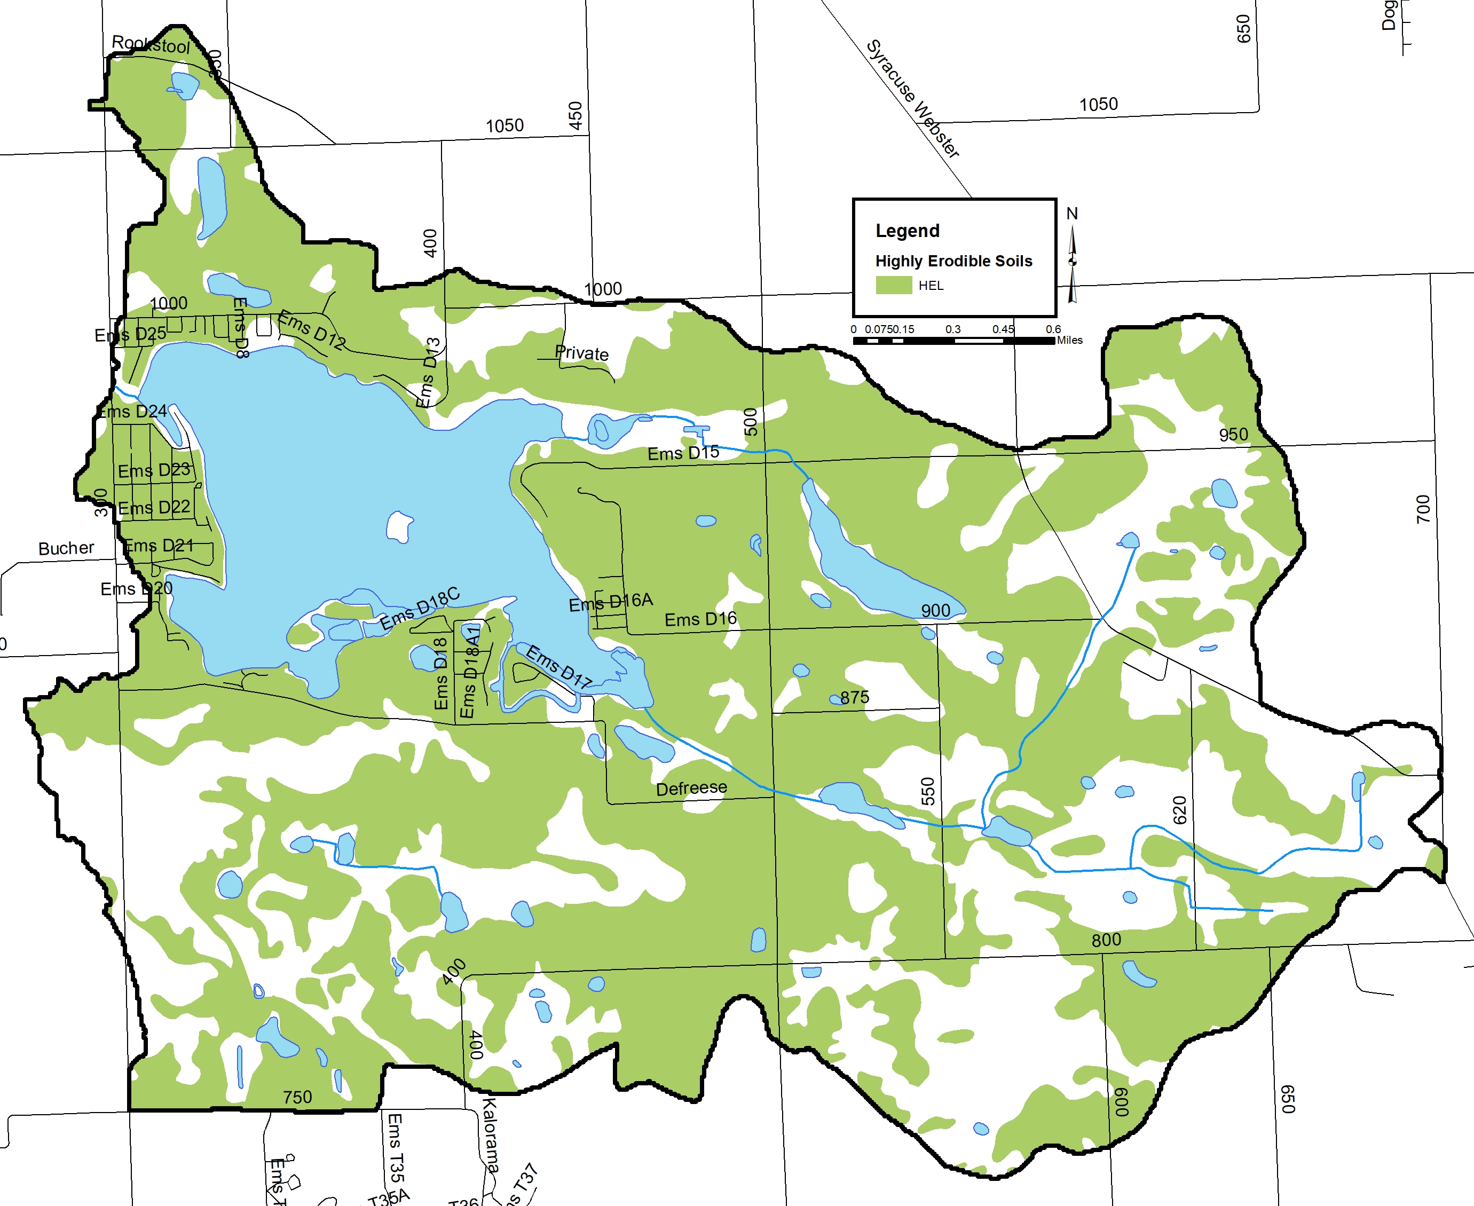
Soil Erodibility
3,129 acres or 57% highly erodible
2008 diagnostic study:
104 acres highly erodible (2%)
2,162 acres potentially highly erodible (43%)

Slide 17
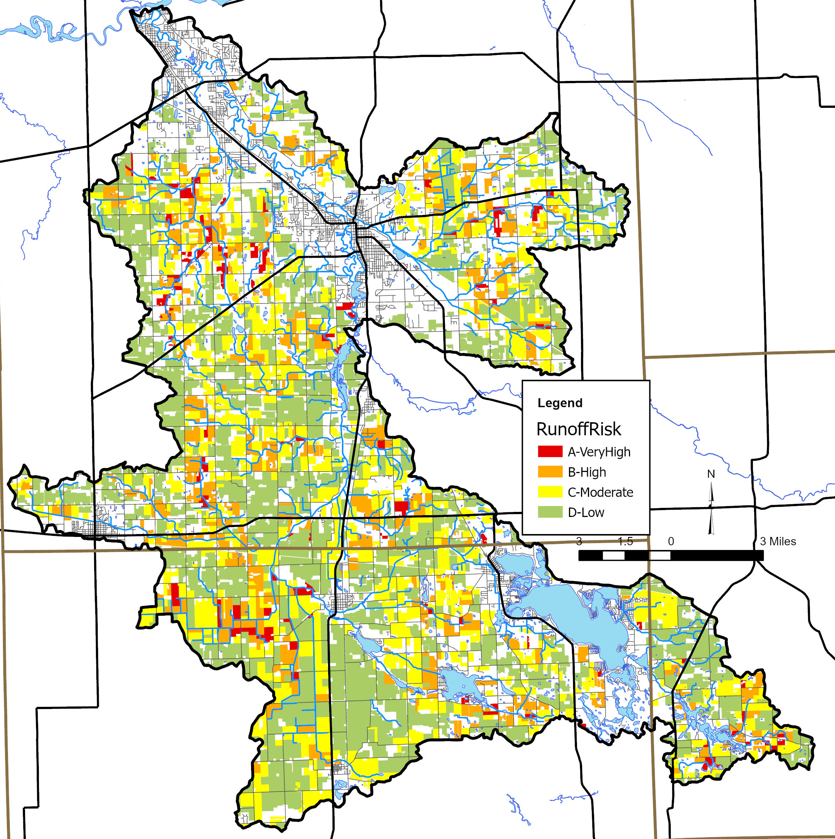
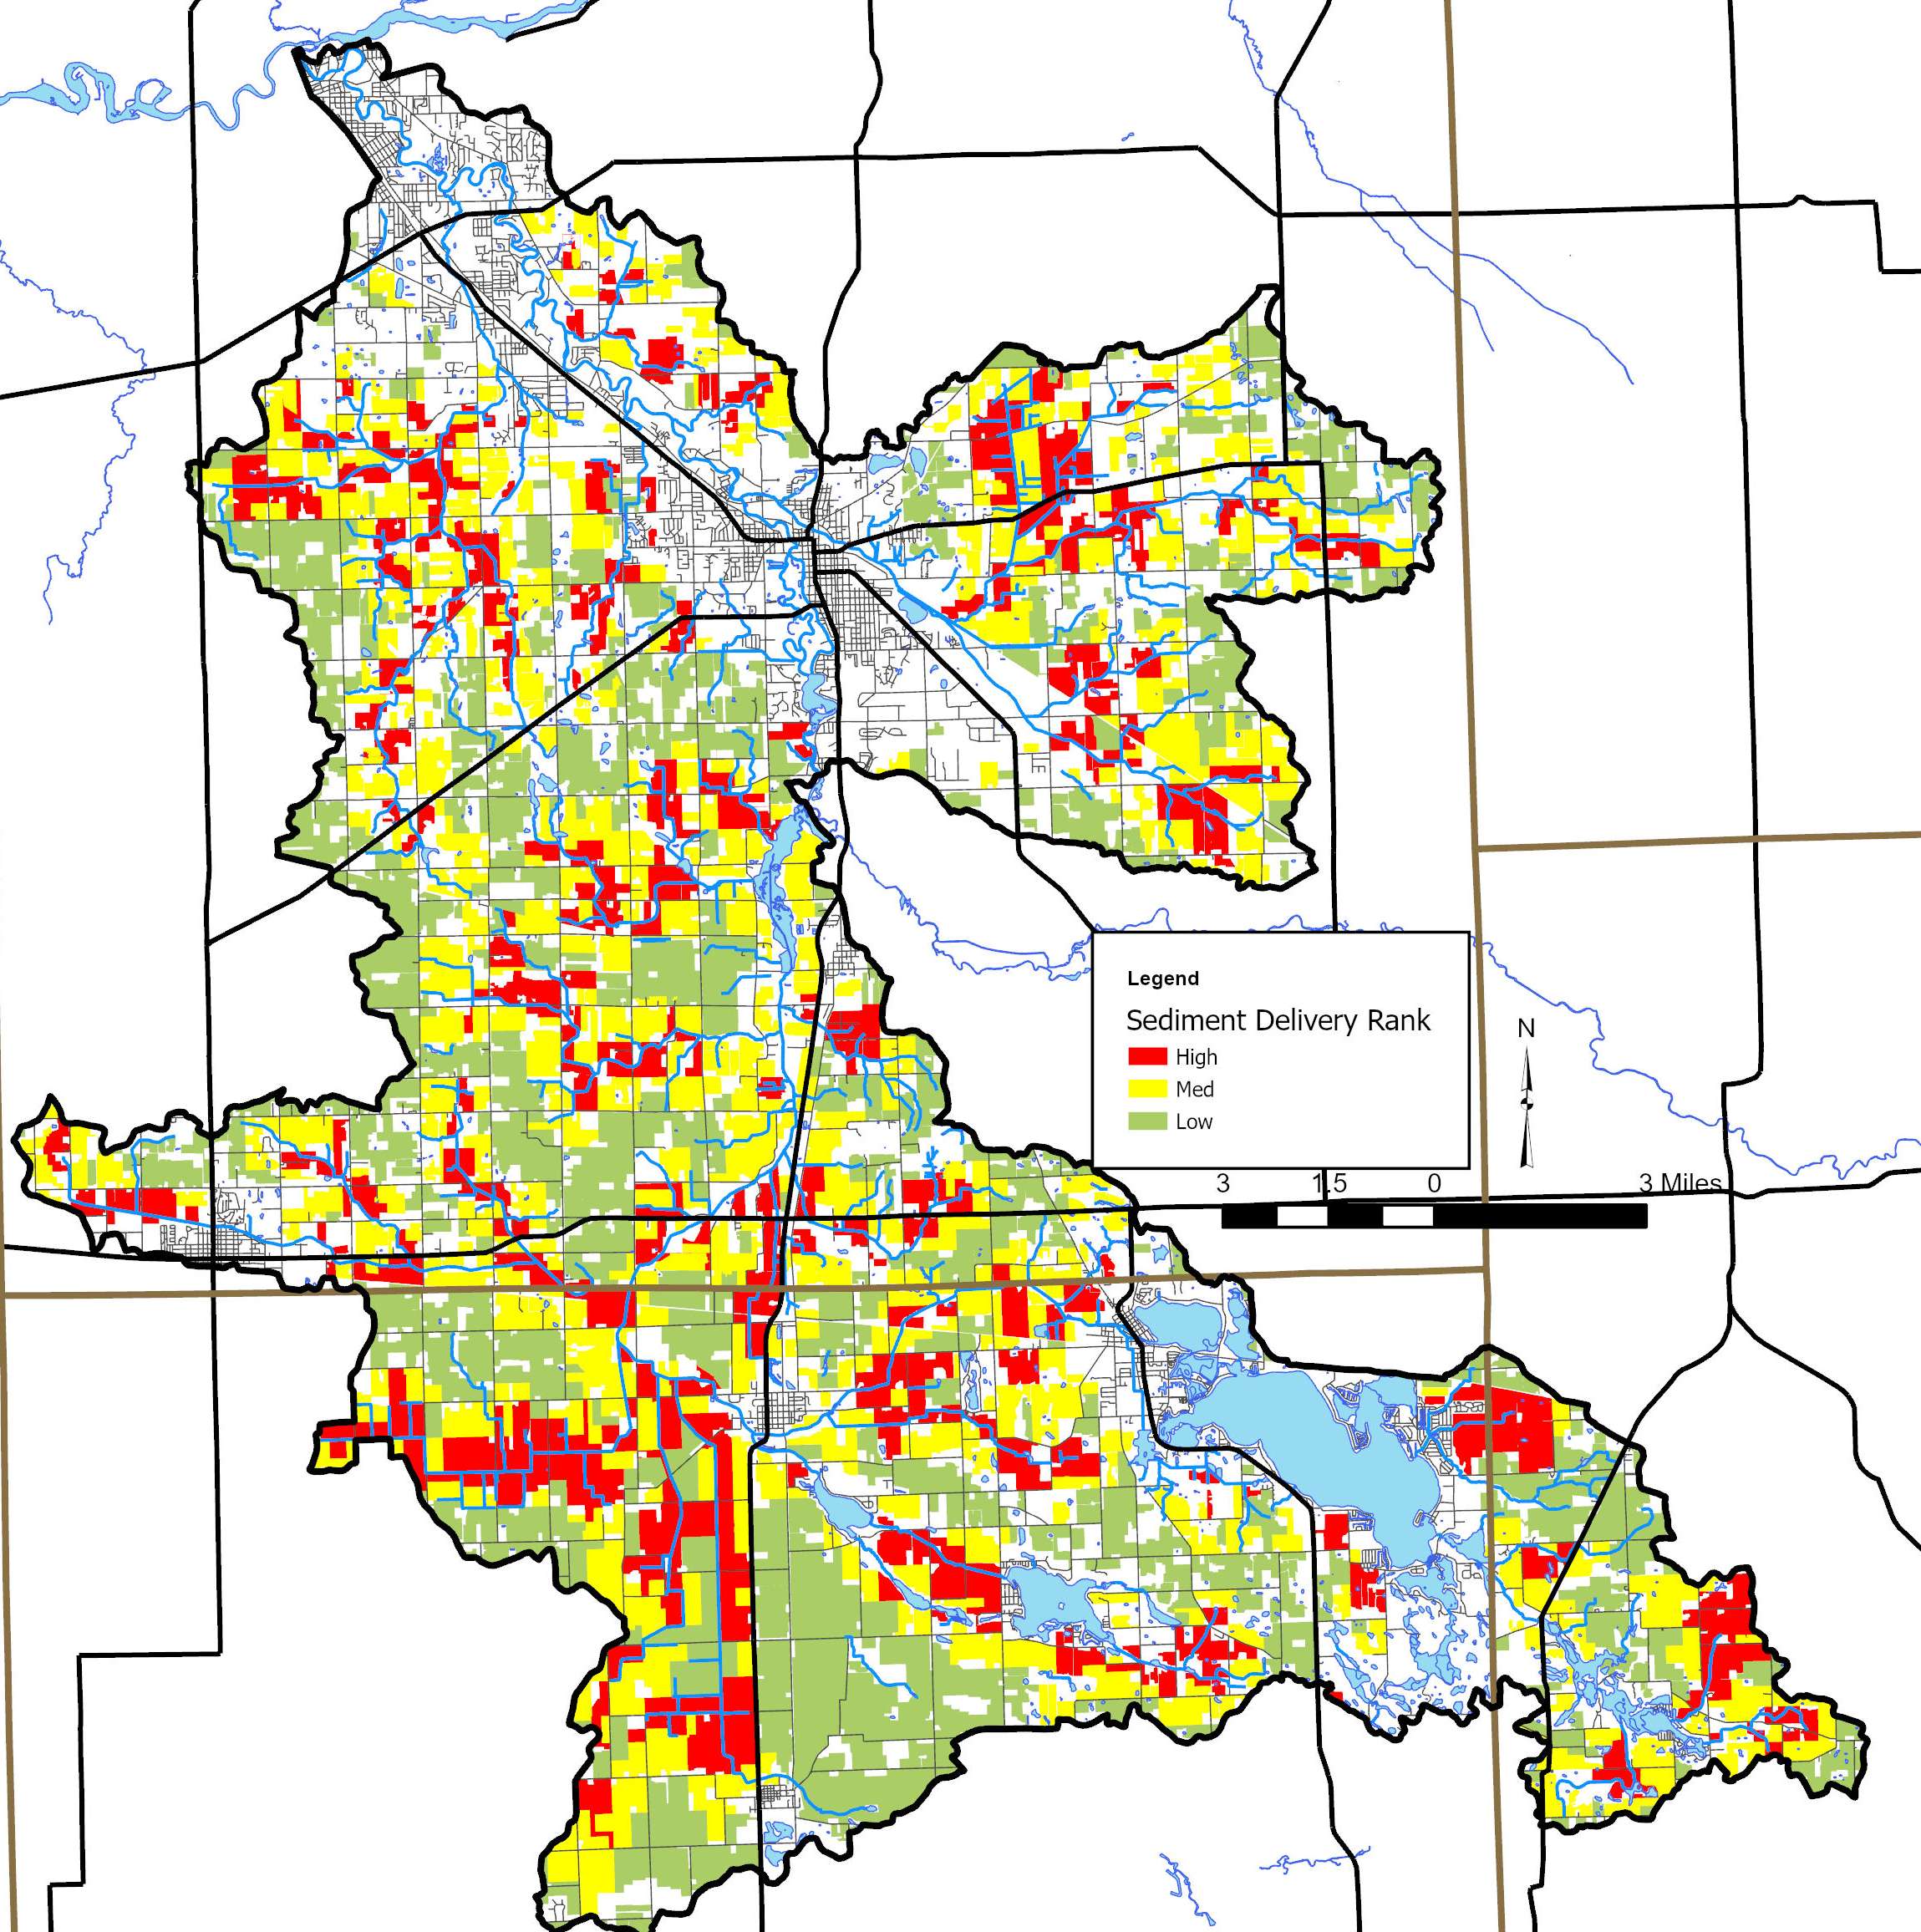
Sediment delivery rank (from lower Elkhart wMP)

Slide 18
dewart lake: data collection water quality data

Slide 19
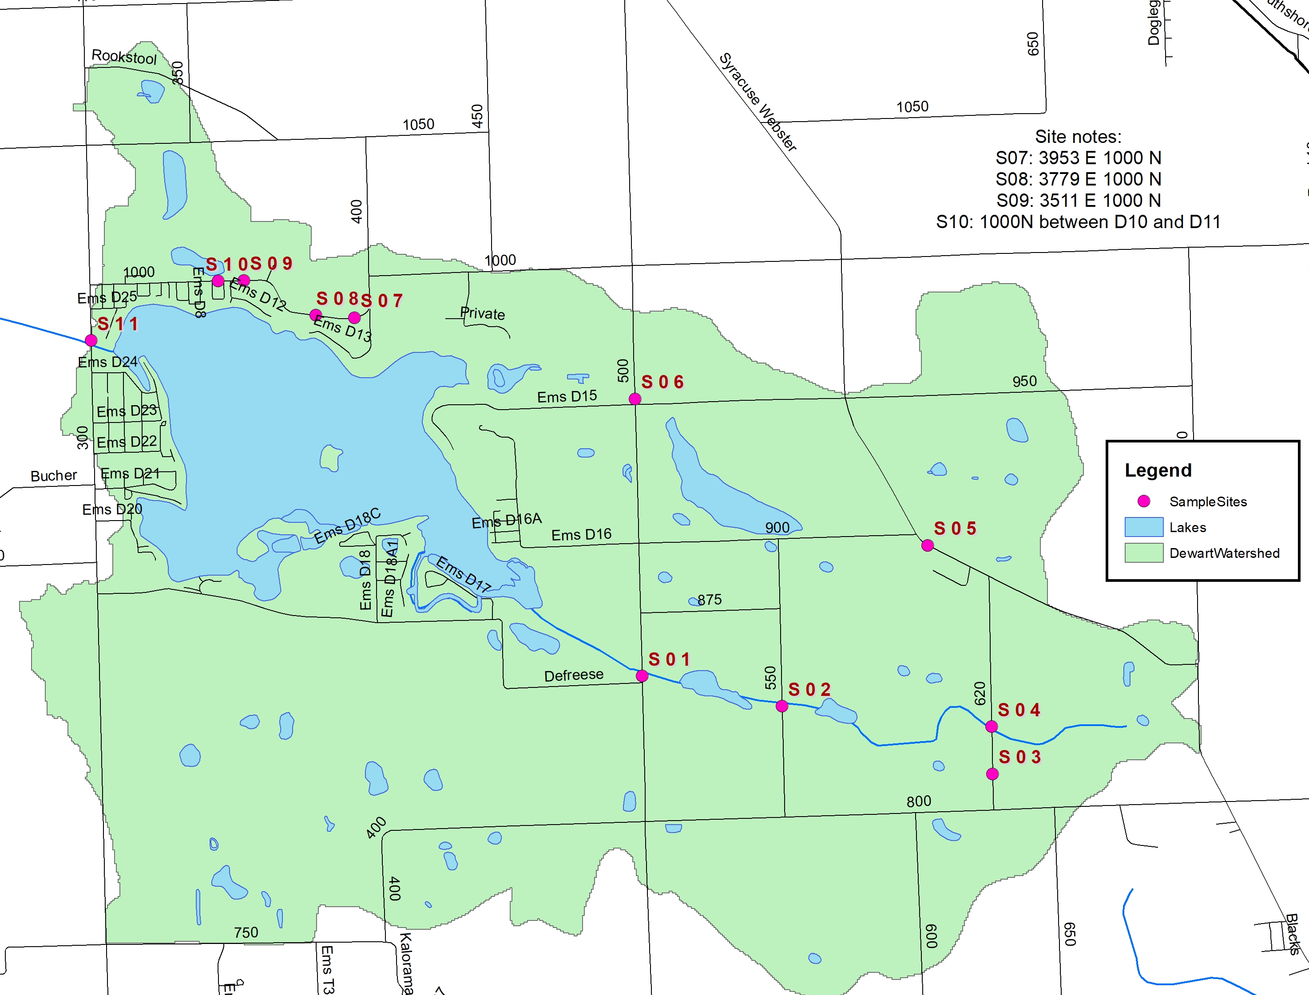
Stream sample sites
Storm Flow Stream Sampling (11 sites)
Goal: Sample monthly >0.5” rain
March to June
Samples collected March, April, May…

Slide 20
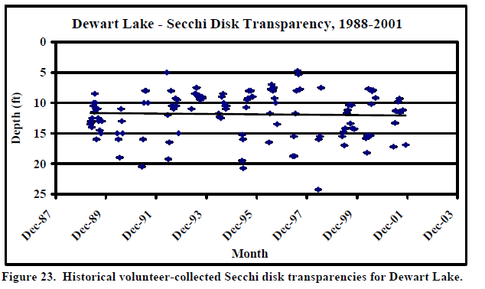
ICLP volunteer data 1989-2001

Slide 21
dewart lake: historic water quality data
Year | Transparency (feet) | Total Phosphorus (mg/L) | Percent Oxic | Plankton Density (#/L) | Cholorphyll a (ug/L)
1988 | 8.9 | 0.150 | 27% | 843 | --
1994 | 7.5 | 0.052 | 37% | 7,213 | 1.03
2000 | 7.2 | 0.036 | 26% | 3,148 | 2.79
2004 | 9.5 | 0.086 | 29% | 729 | 3.33
2008 | 6.2 | 7.340 | 46% | 9,866 | 7.34
2011 | 7.2 | 4.660 | 22% | 46,684 | 4.66
ICLP data 1994-2011
JFNew 2004

Slide 22
Next steps
Continue to analyze mapped and historic water quality data
  Indiana Clean Lakes Program, diagnostic study and DNR fisheries report data
  Plant survey data (historic) and recommendations
Stream storm sampling – June, if possible OR when it rains next
Base flow biological stream sampling (bugs!)
In lake monitoring – July or August (worst case condition)
Utilize data gathered as part of the Lower Elkhart Watershed Planning project to supplement this effort
Inventory – what should this look like in the Dewart Lake Watershed?
Identify problem areas and develop future projects suggestions (prioritize)
Calculate potential impacts
Fall 2024/Spring 2025 public meeting to share findings

Slide 23
How you can help?
Provide feedback
  What are we missing?
  Are there known problem areas in the lake (shoreline erosion, aquatic plant problems, etc)?
  What about the watershed (streambank erosion, ravine erosion, narrow buffers, logjams, areas where dumping occurs, etc)?
  Any available water quality data?
  Are updates or repairs needed for previously-installed ravine stabilization projects?
Consider volunteer water quality monitoring – Indiana Clean Lakes Program provides equipment and training

Slide 24
Questions?
Sara Peel
Arion Consultants
speel@arionconsultants.com
765-337-9100

